Slide 1


Hotel Management System Database Project
Our Hotel Management System Database Project streamlines operations for multiple hotel companies. It offers comprehensive booking management, customer profiling, and company administration features. The system's robust architecture ensures efficient data handling and seamless user experience.

Slide 2
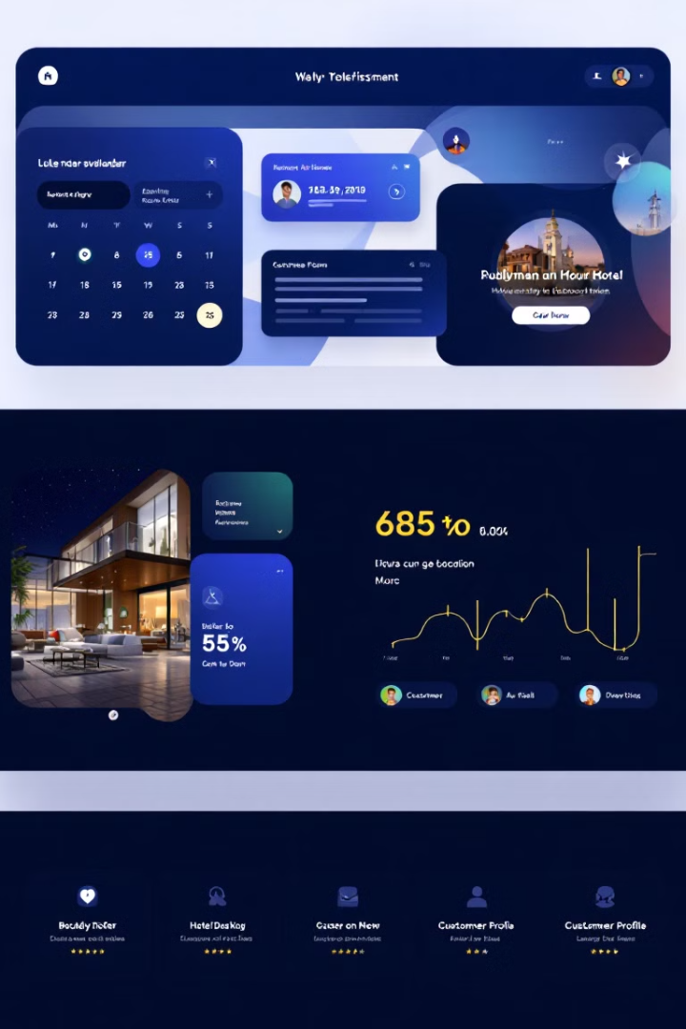
Core Features Overview
1
Multi-Company Management
2
User Account System
Enables hotel companies to update room availability in real-time, ensuring accurate booking information.
Supports multiple hotel operating companies, allowing centralized property management across diverse portfolios.
3
Customer Management
4
Reservation System
Offers a robust booking management system with detailed reservation tracking and modification capabilities.
Facilitates customer registration and comprehensive booking history tracking for personalized service delivery.

Slide 3
Database Structure: Key Tables
1
HotelOperatingCompany
Stores company credentials, contact details, and operational information for each hotel chain.
2
Hotel
Contains individual hotel data, including ratings, amenities, and location information.
3
Room
Manages room details, pricing structures, and available amenities for each hotel property.
4
Customer
Maintains customer profiles, preferences, and loyalty program information for personalized service.
5
Booking
Records all booking transactions, including check-in/out dates, room assignments, and special requests.

Slide 4
Technical Implementation: Design Features
Comprehensive Relationships
Data Integrity
Performance Optimization
Employs constraints to maintain data accuracy and prevent invalid entries in the system.
Implements extensive foreign key relationships to ensure data consistency across all tables.
Utilizes indexing and unique constraints to enhance query performance and data retrieval speed.

Slide 5
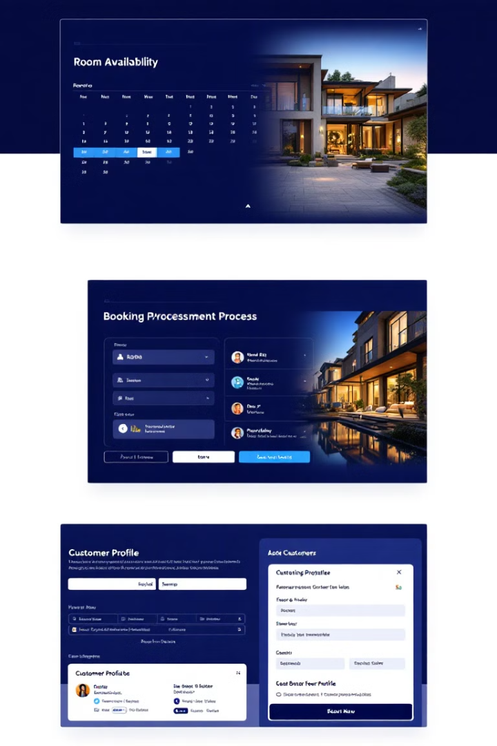




Key Functionalities
Room Availability Management
Real-time updates of room status across all properties, ensuring accurate booking information.
Booking Processing
Streamlined reservation system with automated confirmation and modification capabilities for efficient management.
Customer Profile Management
Comprehensive customer data management, including preferences and booking history for personalized service.
Hotel Company Administration
Centralized control panel for hotel companies to manage properties, rates, and operational data.

Slide 6

Database Query Examples
Query Type
Description
Complexity
Multi-Hotel Companies
Identifies companies managing multiple properties
Medium
Vacancy Analysis
Locates hotels with no current bookings
Low
Customer Patterns
Analyzes booking trends for individual customers
High
Location-Based Search
Finds hotels based on geographic criteria
Medium
Booking Statistics
Calculates average booking durations and frequencies
High

Slide 7
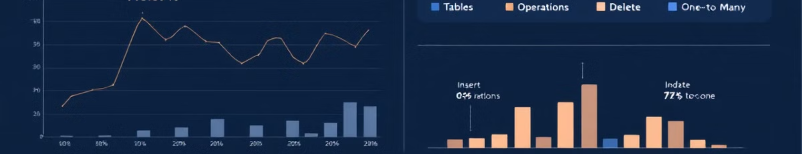




Project Statistics and Relationships
Tables
Operations
Relationships
Data Population
10 interconnected tables form the core of the database structure.
Complete CRUD operations implemented for comprehensive data management.
Multiple relationship types: One-to-Many, Many-to-Many, and One-to-One.
Comprehensive data population for realistic testing and demonstration.

Slide 8

Team Contribution and Development Approach
Equal Contribution
Collaborative Development
Each team member contributed 25% to the project, ensuring balanced input and expertise.
Utilized pair programming and code reviews for high-quality, consistent codebase development.
Workload Distribution
Agile Methodology
Tasks were allocated based on individual strengths, promoting efficient project progression.
Implemented Scrum framework with weekly sprints for adaptive and iterative development process.

